Slide 1


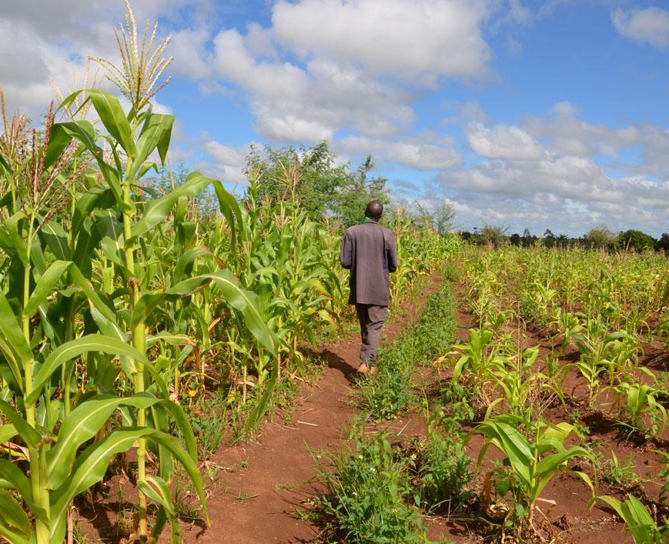

TAMSAT-ALERT for Impact-Based Forecasting
Session 2: Validation of TAMSAT-ALERT for impact-based forecasting

Slide 2


Overview
Listen-along presentation (20-30 minutes)
What is needed for effective impact-based forecasting?
Does TAMSAT-ALERT meet these needs?
Check your understanding (10-15 minutes)
Multiple-choice questions

Slide 3
Learning objectives
Explain TAMSAT-ALERT soil moisture and WRSI as a drought impact-relevant metric
TAMSAT-ALERT soil moisture metrics relate to the impacts of drought
TAMSAT-ALERT forecasts provide sufficient lead-time for early action
There are caveats associated with the use of TAMSAT-ALERT soil moisture forecasts
Understand modelling of soil moisture and WRSI
Understanding TAMSAT-ALERT approach to forecasting
Ability to interpret TAMSAT-ALERT soil moisture and WRSI forecasts
Ability to produce TAMSAT-ALERT forecast plots and/or bulletins

Slide 4
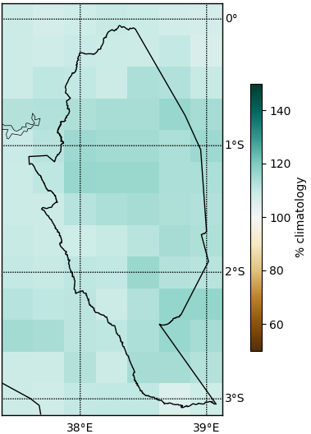
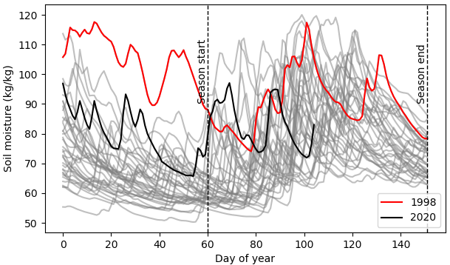
TAMSAT-ALERT soil moisture forecasts
TAMSAT-ALERT forecasts mean seasonal soil moisture
Historic dataset (1983-present) provides a baseline against which to compare
Soil moisture particularly relevant for drought forecasting
Supporting FbA in agricultural and humanitarian sectors
Mean MAM soil moisture forecast for Kitui County, Kenya. Issued on 15th April 2020. Presented as the percent difference from the historical mean (climatology). Blue colours indicated that mean soil moisture is expected to be above average for the 2020 MAM season.
Soil moisture timeseries. Issued on 15th April 2020. Each grey line indicates a single year in the historic dataset. The red line shows 1998 (following heavy rainfall during the 1997 OND season). The black line shows this year, 2020.

Slide 5
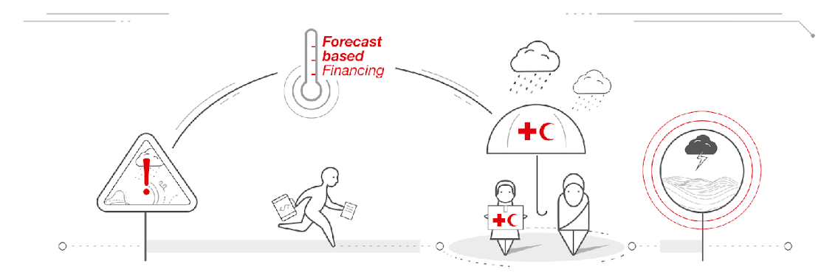
What is FbA?
1.
2.
4.
3.
Image: Red Cross

Slide 6
What is needed for FbA?
1.
2.
Forecast metric must be relevant to the impacts of drought
Forecast must be reliable with sufficient lead-time
Image: Red Cross

Slide 7
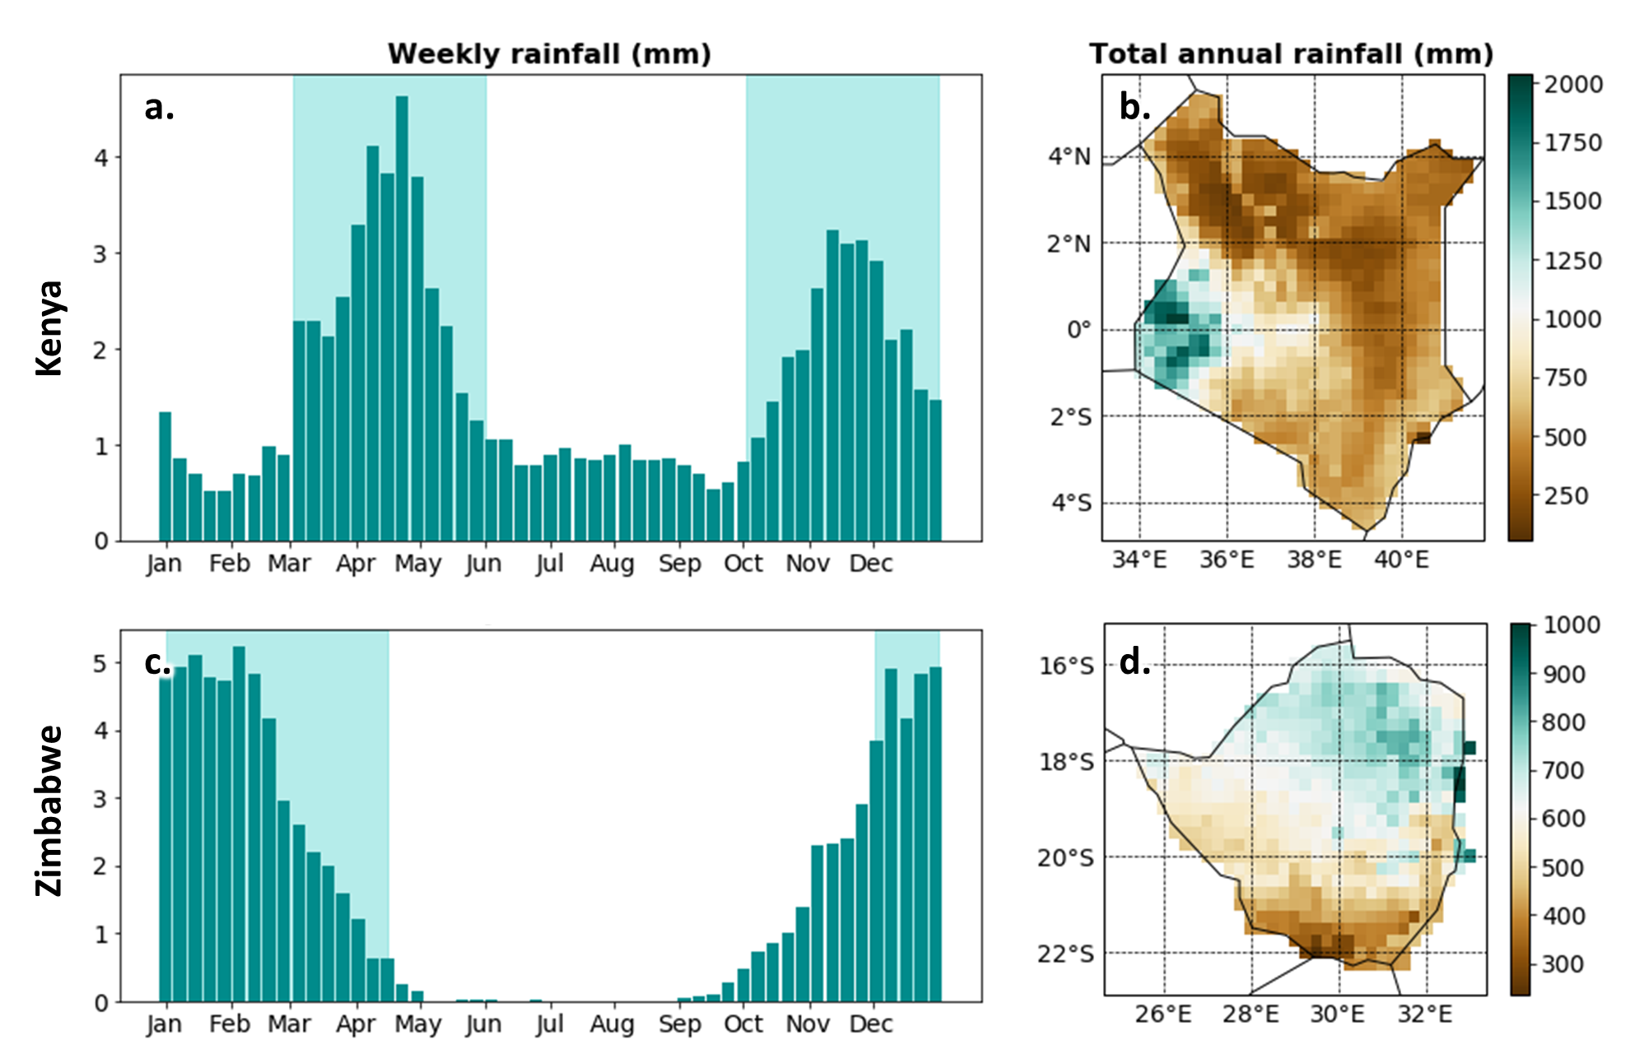
Study countries
The distribution of rainfall in space and time for study countries. In Kenya, rainfall is largely restricted to two wet seasons: the October-November-December ‘short rains’ and the March-April-May ‘long rains’ (a). Mean total annual rainfall is widely below 800mm with the exception of western counties (b). In Zimbabwe, rain falls almost entirely within the December-to-April rainy season (c). There is a clear north-south gradient in mean annual rainfall totals, with northern regions receiving more rainfall on average than southern regions (d).

Slide 8
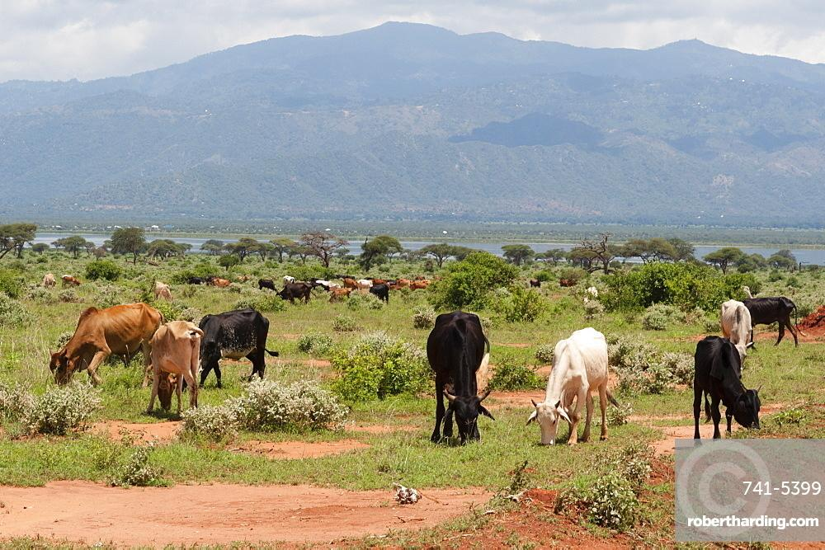
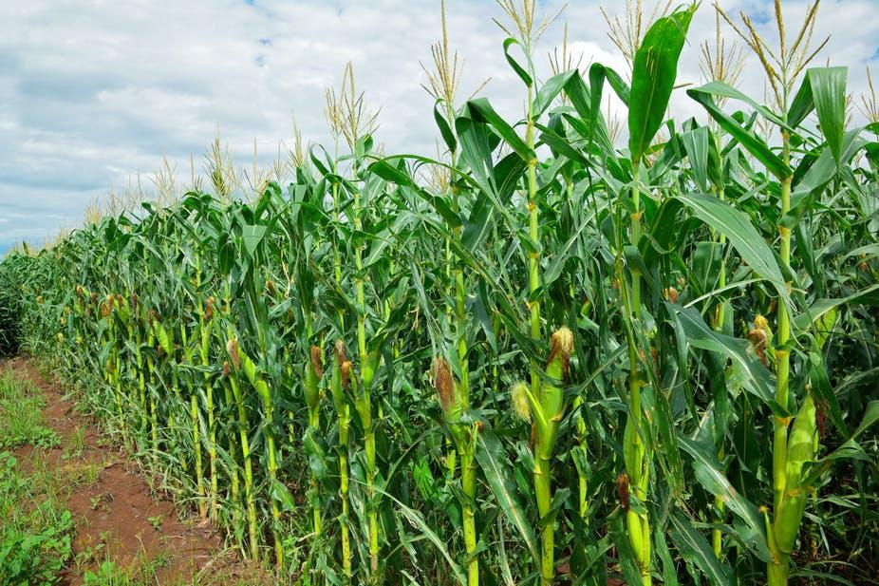
1. Forecast metric must be relevant to impacts of drought
FOOD INSECURITY
Pasture availability
Crop yield
Vegetation Condition Index (VCI)
Maize production
~
~
Soil moisture
Water Resource Satisfaction Index (WRSI)

Slide 9
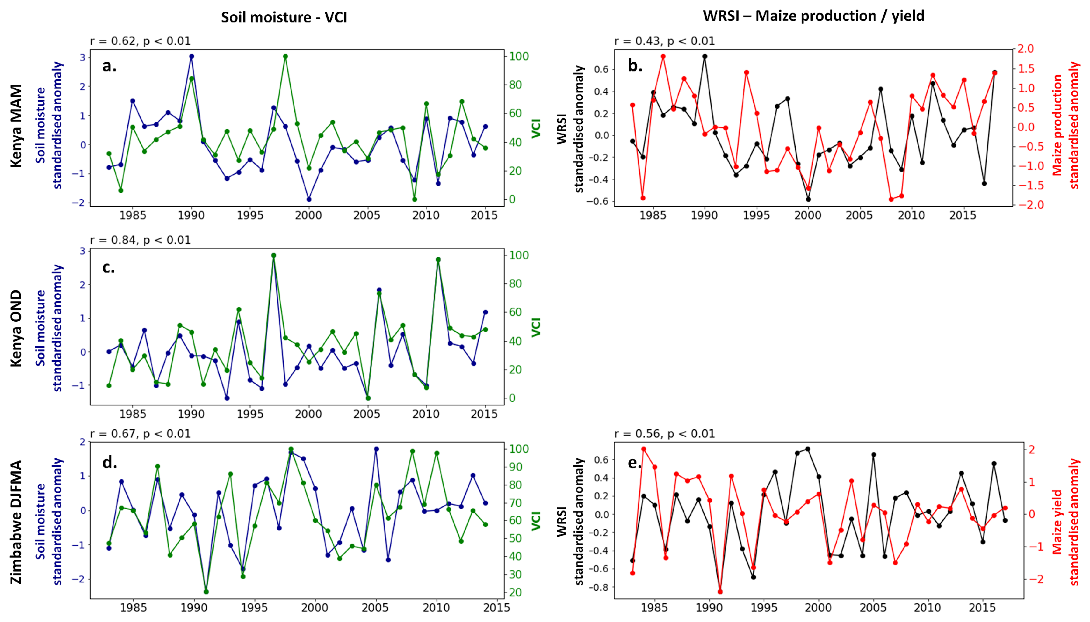
1. Forecast metric must be relevant to impacts of drought
Time series of soil moisture estimates compared to vegetation indices. All metrics are averaged across the season with the exception of yield, which is an annual total. Soil moisture, WRSI and yield anomalies have been standardised. Pearson’s correlation coefficients are presented above each plot. For both regions and all seasons, soil moisture and vegetation indices are significantly and positively correlated.

Slide 10
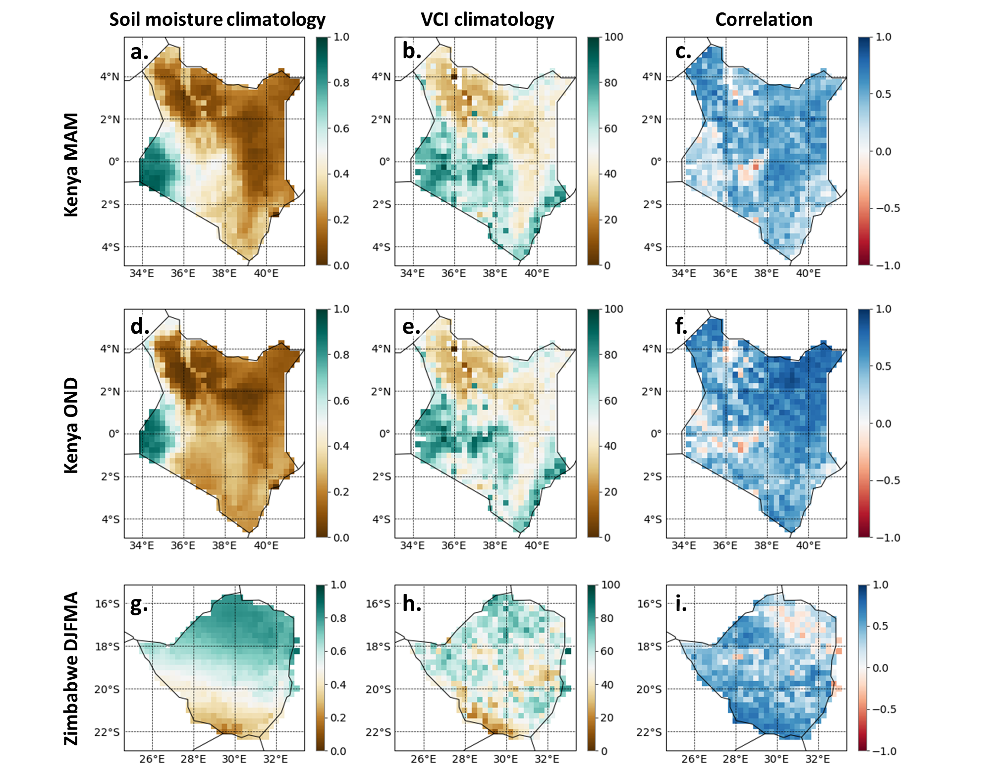
1. Forecast metric must be relevant to impacts of drought
A comparison of soil moisture and VCI climatology across Kenya and Zimbabwe for each wet season. Pearson’s correlation (r) is presented in the third column, where darker blue colours show a strong positive correlation and red shows a negative correlation.

Slide 11
1. Forecast metric must be relevant to impacts of drought
FOOD INSECURITY
Pasture availability
Crop yield
Vegetation Condition Index (VCI)
Maize production
~
~
Soil moisture
Water Requirement Satisfaction Index (WRSI)

Slide 12
2. Forecast must be reliable with sufficient lead-time
1.
2.
Image: Red Cross

Slide 13
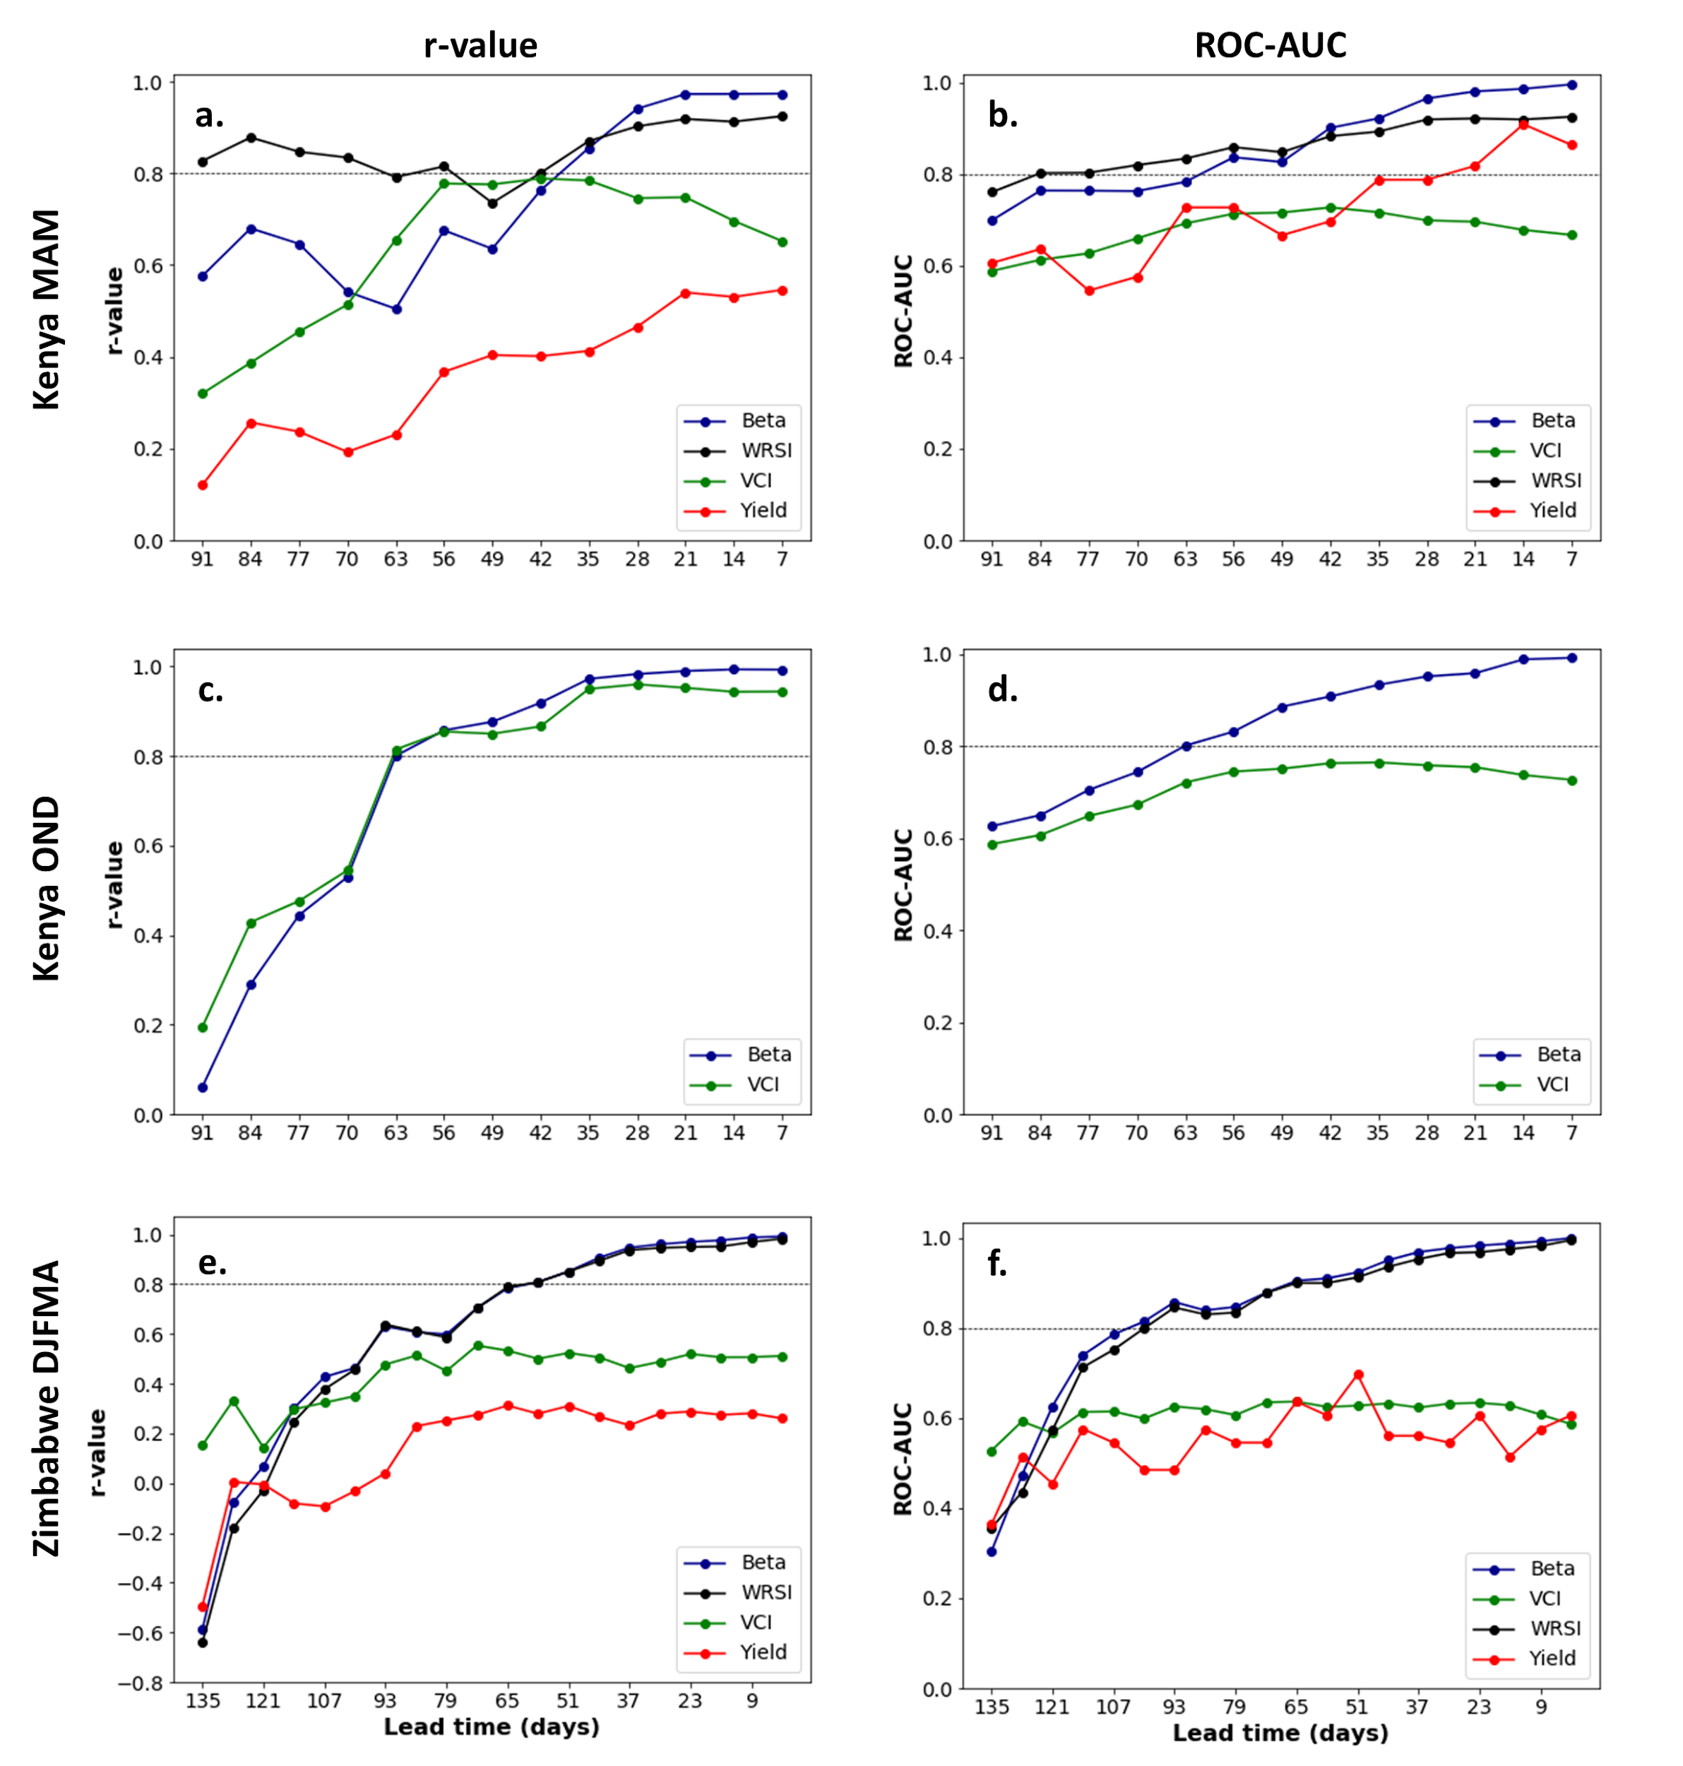
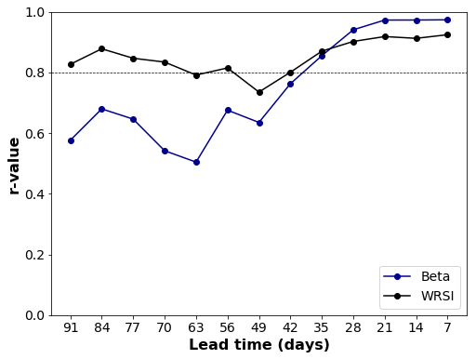
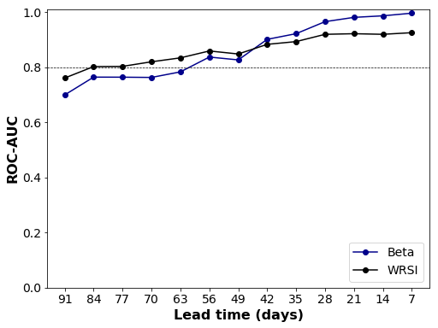
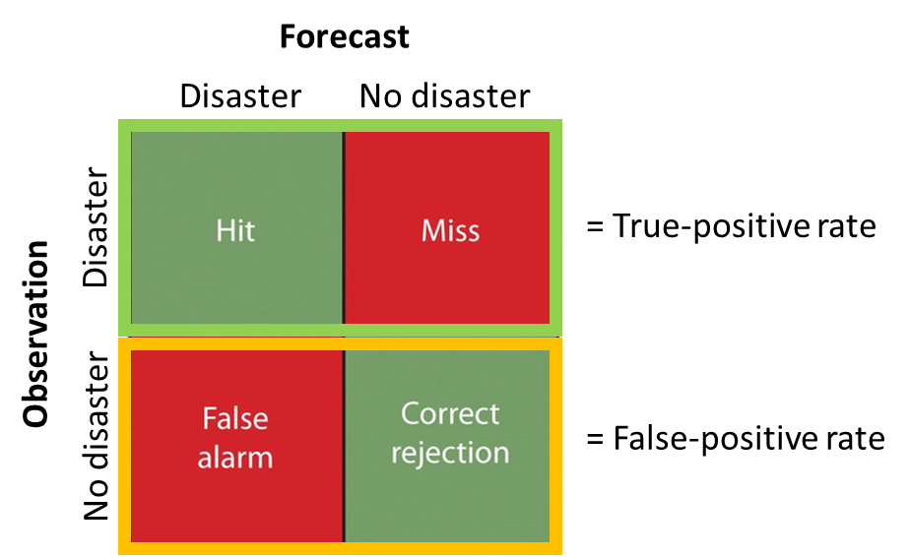
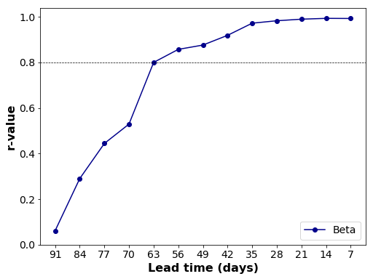
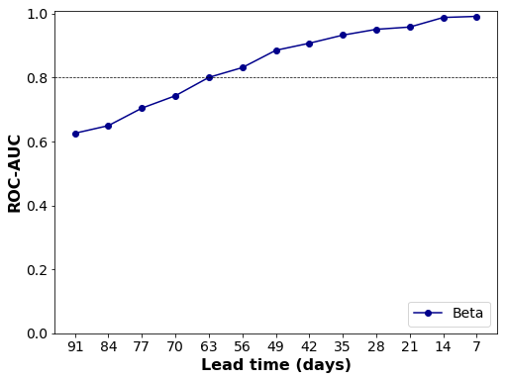
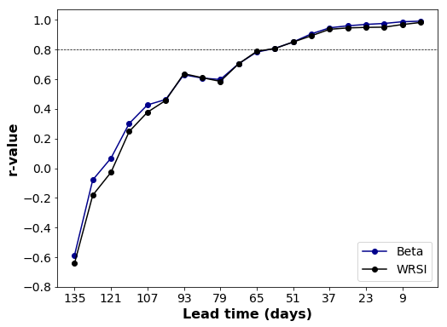
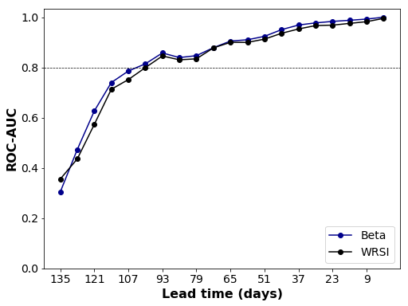
2. Forecast must be reliable with sufficient lead-time
Skill of TAMSAT-ALERT soil moisture forecasts as the season progresses. The first column shows the correlation between mean seasonal soil moisture, WRSI, VCI and yield against the forecast soil moisture ensemble mean. The second column shows the ROC scores of the ensemble mean for identifying <20th percentile seasonal soil moisture, WRSI, VCI and yield, at a range of lead times.

Slide 14
Summary
1.
2.
Forecast metric must be relevant to the impacts of drought
Forecast must be reliable with sufficient lead-time
Image: Red Cross

Slide 15
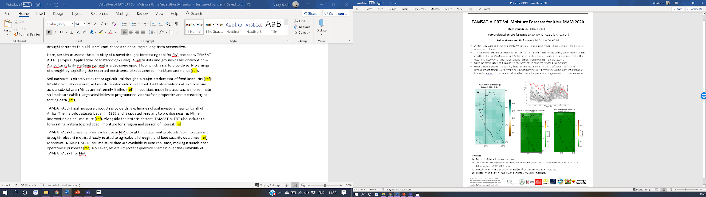
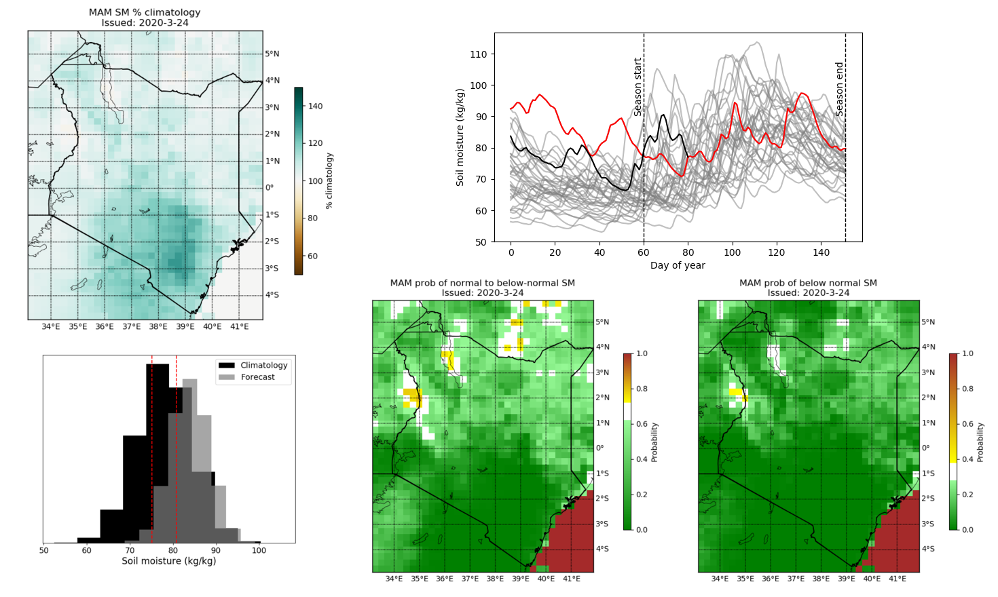
Operational forecasts
Forecasts updated every 5 days
Monitor probability of drought
Trigger early action

Slide 16

Learning objectives
Explain TAMSAT-ALERT soil moisture and WRSI as a drought impact-relevant metric
TAMSAT-ALERT soil moisture metrics relate to the impacts of drought
TAMSAT-ALERT forecasts provide sufficient lead-time for early action
There are caveats associated with the use of TAMSAT-ALERT soil moisture forecasts
Understand modelling of soil moisture and WRSI
Understanding TAMSAT-ALERT approach to forecasting
Ability to interpret TAMSAT-ALERT soil moisture and WRSI forecasts
Ability to produce TAMSAT-ALERT forecast plots and/or bulletins

Slide 17
What’s next?
Check your understanding: Session 2 – Check your understanding
Get in touch
End-of-week clinics (Friday 8th May @ 10:00 - 11:30am)
1-on-1 session: https://doodle.com/poll/a44uig64gzmbbwyc
Email me (v.l.boult@reading.ac.uk)
Next session: TAMSAT-ALERT methodology

